Slide 1

WELCOME
COHORT 5
7th Sept – 3rd Dec 2026
Suite 6-6-7, Level 6, Menara MAA

Slide 2
Contents
Understanding Props & Data Flow
Implementation & Best Practices
Practice - Building Reusable Components
Notes:
/* General Page Styling */
body {
font-family: Arial, sans-serif;
background-color: #f9f9f9;
padding: 20px;
}
/* Restaurant Header */
h1 {
color: #333;
font-size: 32px;
}
p {
font-size: 16px;
color: #555;
}
/* Section for Each Category */
h2 {
margin-top: 30px;
font-size: 24px;
color: #222;
}
/* Menu Item Box */
.menu-item {
background-color: white;
border: 1px solid #ddd;
border-radius: 10px;
padding: 15px;
margin-bottom: 20px;
max-width: 400px;
box-shadow: 0 0 5px rgba(0, 0, 0, 0.1);
}
/* Menu Item Image */
.menu-item img {
width: 100%;
border-radius: 10px;
margin-bottom: 10px;
}
/* Price and Tags */
.menu-item h3 {
margin: 5px 0;
}
.menu-item p {
margin: 5px 0;
}
/* Order Now Button */
.menu-item button {
background-color: #28a745;
color: white;
border: none;
padding: 8px 12px;
border-radius: 5px;
cursor: pointer;
margin-top: 10px;
}
.menu-item button:hover {
background-color: #218838;
}

Slide 3
What are Props?
Props = Properties passed from parent to child components
Unidirectional data flow - data flows down the component tree
Read-only - components cannot modify their own props
Communication mechanism between components

Slide 4
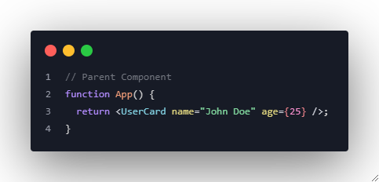
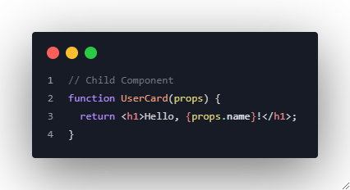
What are Props?

Slide 5
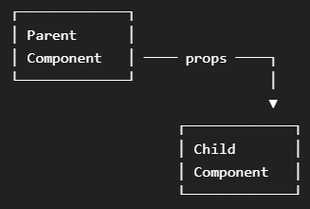
Data Flow in React
Key Principles:
Data flows down (parent to child)
Events flow up (child to parent via callbacks)
Props are immutable within the receiving component

Slide 6
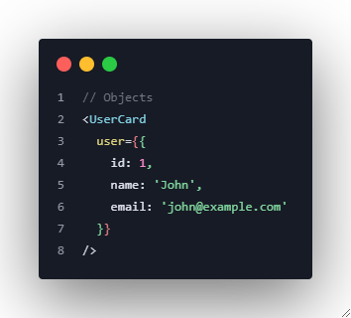
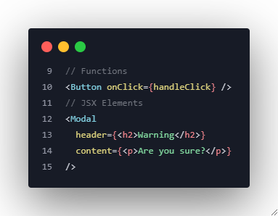
Passing Different Data Types

Slide 7
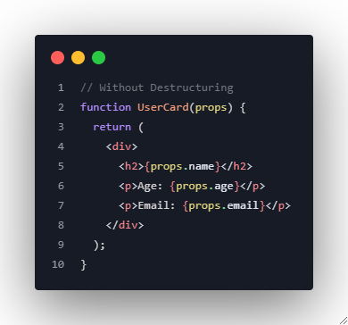
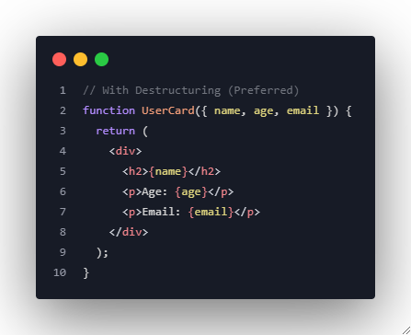
Props Destructuring

Slide 8
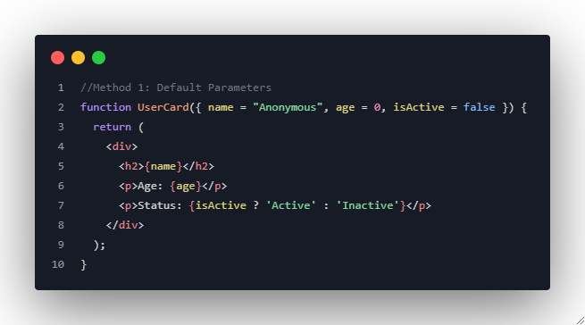
Default Values

Slide 9
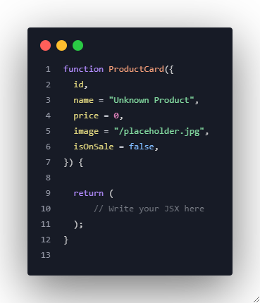
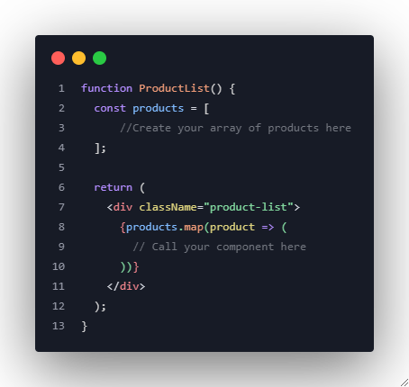
Practical Example: Product Card Component
Notes:
//Product Card
function ProductCard({
id,
name = "Unknown Product",
price = 0,
image = "/placeholder.jpg",
isOnSale = false,
onAddToCart
}) {
const handleAddToCart = () => {
if (typeof onAddToCart === 'function') {
onAddToCart(id, name, price);
} else {
console.warn('onAddToCart is not a function');
}
};
return (
<div className="product-card">
<img src={image} alt={name} />
<h3>{name}</h3>
<div className="price">
<span className={isOnSale ? 'sale-price' : ''}>
${price.toFixed(2)}
</span>
{isOnSale && <span className="sale-badge">SALE!</span>}
</div>
<button onClick={handleAddToCart}>
Add to Cart
</button>
</div>
);
}
// ProductList
function ProductList() {
const products = [
{
id: 1,
name: "Laptop",
price: 999.99,
image: "/images/laptop.jpg",
isOnSale: true
},
{
id: 2,
name: "Mouse",
price: 29.99,
image: "/images/mouse.jpg"
}
];
const handleAddToCart = (id, name, price) => {
console.log(`Added ${name} (${id}) - $${price} to cart`);
// Add to cart logic here
};
return (
<div className="product-list">
{products.map(product => (
<ProductCard
key={product.id}
{...product}
onAddToCart={handleAddToCart}
/>
))}
</div>
);
}

Slide 10
Mini-Project: Restaurant Menu Display
Create a new React project or use your existing project
Create a new file called MenuApp.jsx in your src folder
You'll be building 4 main components:
RestaurantHeader
MenuItem
MenuCategory
MenuApp (main component)

Slide 11
Mini-Project: Restaurant Menu Display
Step 1: Create the RestaurantHeader Component
File: RestaurantHeader.jsx
Create a component that displays restaurant information:
Props to accept:
restaurantName (string, default: "Our Restaurant")
tagline (string, default: "Delicious food for everyone")
rating (number, default: 0)
cuisine (string, default: "International")
Notes:
Code Example
============
function RestaurantHeader(props) {
const stars = "⭐".repeat(props.rating);
return (
<div>
<h1>{props.restaurantName}</h1>
<p>{props.tagline}</p>
<p>Cuisine: {props.cuisine}</p>
<p>Rating: {stars}</p>
</div>
);
}
export default RestaurantHeader;

Slide 12
Mini-Project: Restaurant Menu Display
Requirements:
Display the restaurant name as an <h1>
Show the tagline as a paragraph
Display the cuisine type
Show star rating (you can use ⭐ emoji)
Create a function to render stars based on the rating number

Slide 13
Mini-Project: Restaurant Menu Display
Step 2: Create the MenuItem Component
File: MenuItem.jsx
Build a component for individual menu items:
Props to accept:
name (string, default: "Menu Item")
description (string, default: "")
price (number, default: 0)
category (string, default: "general")
isVegetarian (boolean, default: false)
isSpicy (boolean, default: false)
image (string, default: "/default-food.jpg")
onOrder (function)
Notes:
Code Example
============
function MenuItem(props) {
return (
<div className="menu-item">
<img src={props.image} alt={props.name} width="150" />
<h3>{props.name} - ${props.price.toFixed(2)}</h3>
{props.description && <p>{props.description}</p>}
<p>
{props.isVegetarian ? "🌱" : null}
{props.isSpicy ? "🌶️" : null}
</p>
<button onClick={() => props.onOrder(props.name, props.price)}>
Order Now
</button>
</div>
);
}
export default MenuItem;

Slide 14
Mini-Project: Restaurant Menu Display
Requirements:
Display item image, name, and price
Show description if provided
Add tags for vegetarian (🌱) and spicy (🌶️) items
Include an "Order Now" button that calls the onOrder function
Use conditional rendering for tags and description
Format price to 2 decimal places using toFixed(2)

Slide 15
Mini-Project: Restaurant Menu Display
Step 3: Create the MenuCategory Component
File: MenuCategory.jsx
Create a component that groups menu items by category:
Props to accept:
categoryName (string, default: "Category")
items (array, default: [])
onItemOrder (function)
Notes:
==============
Code Example
==============
import MenuItem from "./MenuItem";
function MenuCategory(props) {
return (
<div>
<h2>{props.categoryName}</h2>
{props.items.length === 0 ? (
<p>No items available in this category</p>
) : (
props.items.map((item) => (
<MenuItem
key={item.id}
name={item.name}
description={item.description}
price={item.price}
category={item.category}
isVegetarian={item.isVegetarian}
isSpicy={item.isSpicy}
image={item.image}
onOrder={props.onItemOrder}
/>
))
)}
</div>
);
}
export default MenuCategory;

Slide 16
Mini-Project: Restaurant Menu Display
Requirements:
Display category name as an <h2>
Check if items array is valid and not empty
If no items, show "No items available in this category"
Map through items and render MenuItem components
Pass the onItemOrder function down to each MenuItem
Use the spread operator ({...item}) to pass all item props

Slide 17
Mini-Project: Restaurant Menu Display
Step 4: Create the Main MenuApp Component
File: MenuApp.jsx
Build the main component that brings everything together:
Requirements:
Create restaurant info object (Use the code displayed in the presenter’s notes)
Create menu data object with 3 categories:
  Appetizers: At least 2 items
  Main Courses: At least 3 items
  Desserts: At least 1 item
Notes:
const restaurantInfo = {
restaurantName: "Bella Vista",
tagline: "Authentic Italian Cuisine",
rating: 4.5,
cuisine: "Italian"
};
============
Code Example
============
import './App.css';
import RestaurantHeader from "./components/RestaurantHeader";
import MenuCategory from "./components/MenuCategory";
function App() {
const restaurantInfo = {
restaurantName: "Foodie Place",
tagline: "Best bites in town",
rating: 4,
cuisine: "Fusion"
};
const appetizers = [
{
id: 1,
name: "Spring Rolls",
description: "Crispy and light",
price: 5.99,
category: "Appetizers",
isVegetarian: true,
isSpicy: false,
image: "/spring-rolls.jpg"
},
{
id: 2,
name: "Chicken Wings",
description: "Spicy and juicy",
price: 6.99,
category: "Appetizers",
isVegetarian: false,
isSpicy: true,
image: "/chicken-wings.jpg"
}
];
const mainCourses = [
{
id: 3,
name: "Grilled Chicken",
description: "Served with rice",
price: 11.99,
category: "Main",
isVegetarian: false,
isSpicy: false,
image: "/grilled-chicken.jpg"
},
{
id: 4,
name: "Veggie Curry",
description: "Mild and creamy",
price: 9.5,
category: "Main",
isVegetarian: true,
isSpicy: false,
image: "/veggie-curry.jpg"
},
{
id: 5,
name: "Spicy Beef Stew",
description: "Hot and hearty",
price: 13.0,
category: "Main",
isVegetarian: false,
isSpicy: true,
image: "/beef-stew.jpg"
}
];
const desserts = [
{
id: 6,
name: "Chocolate Cake",
description: "Rich and moist",
price: 4.99,
category: "Dessert",
isVegetarian: true,
isSpicy: false,
image: "/chocolate-cake.jpg"
}
];
function handleItemOrder(name, price) {
alert("You ordered: " + name + " - $ " + price.toFixed(2));
console.log("Order placed for: ", name);
}
return (
<div>
<RestaurantHeader
restaurantName={restaurantInfo.restaurantName}
tagline={restaurantInfo.tagline}
rating={restaurantInfo.rating}
cuisine={restaurantInfo.cuisine}
/>
<MenuCategory
categoryName="Appetizers"
items={appetizers}
onItemOrder={handleItemOrder}
/>
<MenuCategory
category="Main Courses"
items={mainCourses}
onItemOrder={handleItemOrder}
/>
<MenuCategory
category="Desserts"
items={desserts}
onItemOrder={handleItemOrder}
/>
</div>
);
}
export default App;

Slide 18
Mini-Project: Restaurant Menu Display
Each menu item should have: (Sample Code in the presenter’s Notes)
  id (number)
  name (string)
  description (string)
  price (number)
  category (string)
  isVegetarian (boolean) - at least 2 vegetarian items
  isSpicy (boolean) - at least 1 spicy item
  image (string)
Create handleItemOrder function:
  Should accept itemName and price parameters
  Display an alert with the order details
  Log the order to console
Notes:
const menuData = {
appetizers: [
{
id: 1,
name: "Bruschetta",
description: "Grilled bread with tomatoes and basil",
price: 8.99,
category: "appetizer",
isVegetarian: true,
isSpicy: false,
image: "/bruschetta.jpg"
}
// Add more items...
],
mains: [
// Add main course items...
],
desserts: [
// Add dessert items...
]
};

Slide 19
Mini-Project: Restaurant Menu Display
Render the complete app:
  RestaurantHeader with restaurant info
  Three MenuCategory components for each category
  Pass appropriate props to each component

Slide 20
Key Learning Objectives
By the end of this session, students should be able to:
✅ Understand how props enable component communication
✅ Pass different data types as props (strings, numbers, objects, arrays, functions)
✅ Use props destructuring for cleaner code
✅ Implement default values for props
✅ Build reusable components that accept props
✅ Handle events through prop functions
✅ Apply conditional rendering based on props

